Slide 1


When marginals or dependencies are unknown: computing with imprecise probabilities
Ander Gray, Scott Ferson
Ander.Gray@Liverpool.ac.uk

Slide 2
Open question
Suppose
A is in [2, 4]
B is in [3, 5]
What can be said about the sum A+B?
The right answer for
risk analysis is [5,9]
4
6
8
10

Slide 3
Uniform
Uniform
Uniform
Uniform
Probability
density

Slide 4
Uniform
Uniform
Uniform
Uniform
Uniform
Uniform
Uniform
Uniform
Uniform
Uniform
Uniform
Uniform
Uniform
Uniform
Uniform
Uniform
Uniform
Uniform
Uniform
Uniform
Uniform
Uniform
Uniform
Uniform
Uniform
Uniform
Uniform
Uniform
Uniform
Uniform
Uniform
Uniform
Uniform
Uniform
Uniform
Uniform
Uniform
Uniform
Uniform
Uniform
Where does this surety come from?
What justifies it?
Probability density

Slide 5

The interval
$$x=\left[x_{1},x_{2}\right]=[\underline{x},\overline{x}]$$
range
x₁
x₂
Used when upper and lower bounds are known reliably
Sometimes absolutely sure, sometimes just a judgment

Slide 6
Why intervals are a good idea
Intervals are easy to understand
Calculations with them are easy
They work with even the crappiest data
Often sufficient for a decision
Quicker than Monte Carlo

Slide 7
Intervals are rigorous
The computations are guaranteed to enclose the true results (so long as the inputs do)
You can still be wrong, but the method won’t be the reason if you are
Outward directed rounding

Slide 8
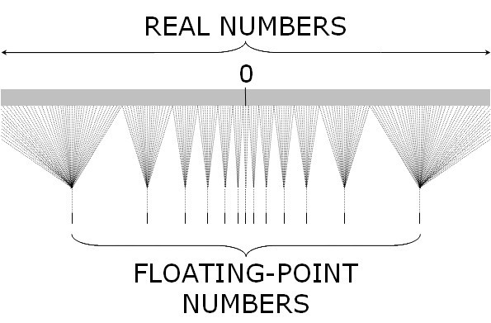
Intervals are rigorous
`
The computations are guaranteed to enclose the true results (so long as the inputs do)
You can still be wrong, but the method won’t be the reason if you are
Outward directed rounding
(automatically verified computing)

Slide 9
Interval arithmetic
x + y = [x₁ + y₁, x₂ + y₂]
x − y = [x₁ − y₂, x₂ − y₁]
x × y = [min(x₁y₁, x₁y₂, x₂y₁, x₂y₂), max(x₁y₁, x₁y₂, x₂y₁, x₂y₂)]
x ÷ y = x × [1/y₂, 1/y₁], if y doesn’t include zero

Slide 10
Interval arithmetic
min(x, y) = [min(x₁, y₁), min(x₂, y₂)]
max(x, y) = [max(x₁, y₁), max(x₂, y₂)]
env(x, y) = [min(x₁, y₁), max(x₂, y₂)]
intersect(x, y) = [max(x₁, y₁), min(x₂, y₂)], if x and y overlap
Simple to implement:
    function overloading
    multiple dispatch

Slide 11
Intervals bound a set of distribution

Slide 12
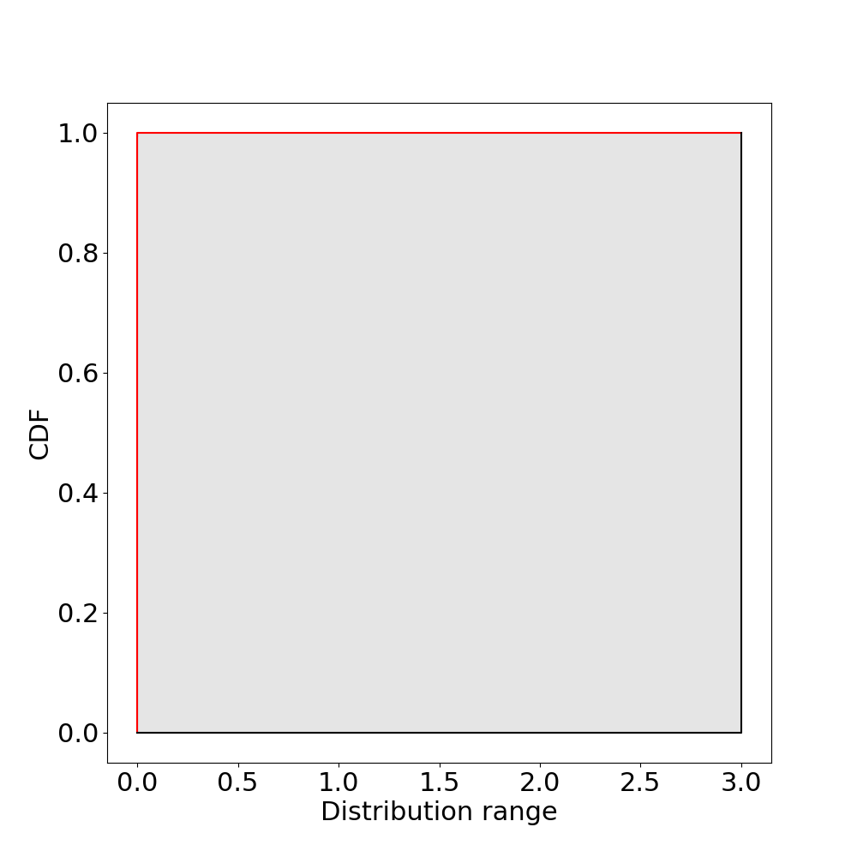

Probability Boxes
cdf bounds:
$$\underline{x}≤F_{X}≤\overline{x}$$

Slide 13
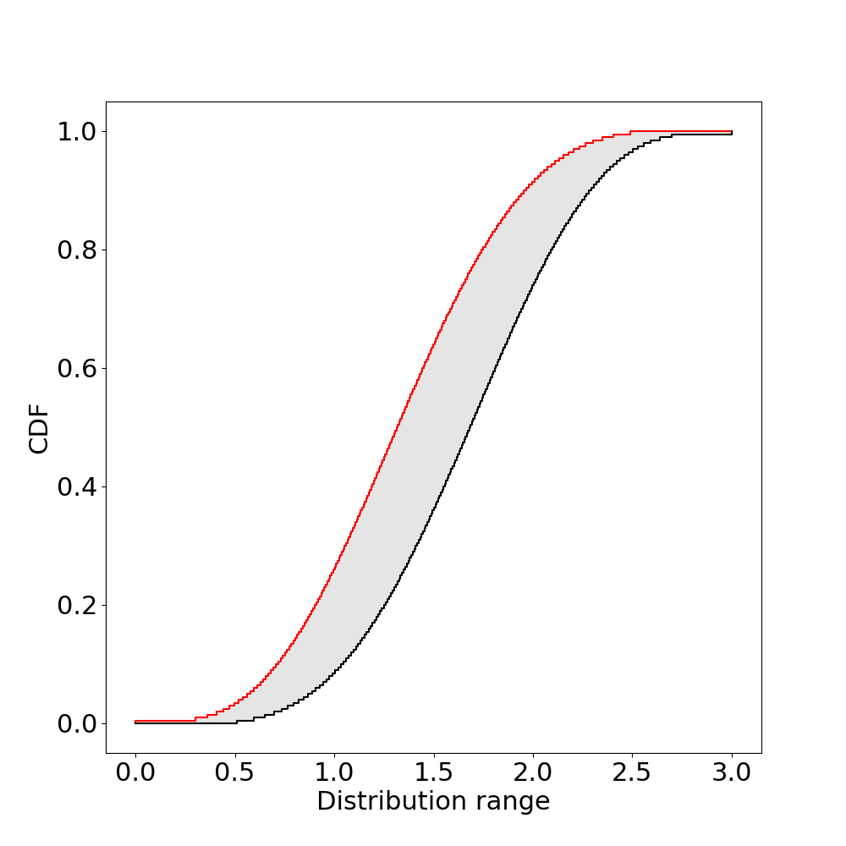
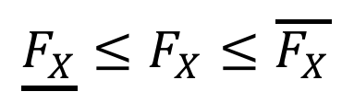



Probability Boxes
(p-box)
cdf bounds:
$$\underline{F_{X}}≤F_{X}≤\overline{F_{X}}$$
$$\overline{F_{X}}$$
$$\underline{F_{X}}$$
Dual interpretation:
Interval $x$ for cdf value

Slide 14
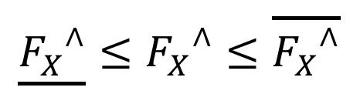

Probability Boxes
(p-box)
Inverse cdf bounds:
$$\underline{{F_{X}}^{∧}}≤{F_{X}}^{∧}≤\overline{{F_{X}}^{∧}}$$
$$\overline{F_{X}}$$
$$\underline{F_{X}}$$
Dual interpretation:
Interval $x$ for cdf value
Interval cdf for $x$

Slide 15
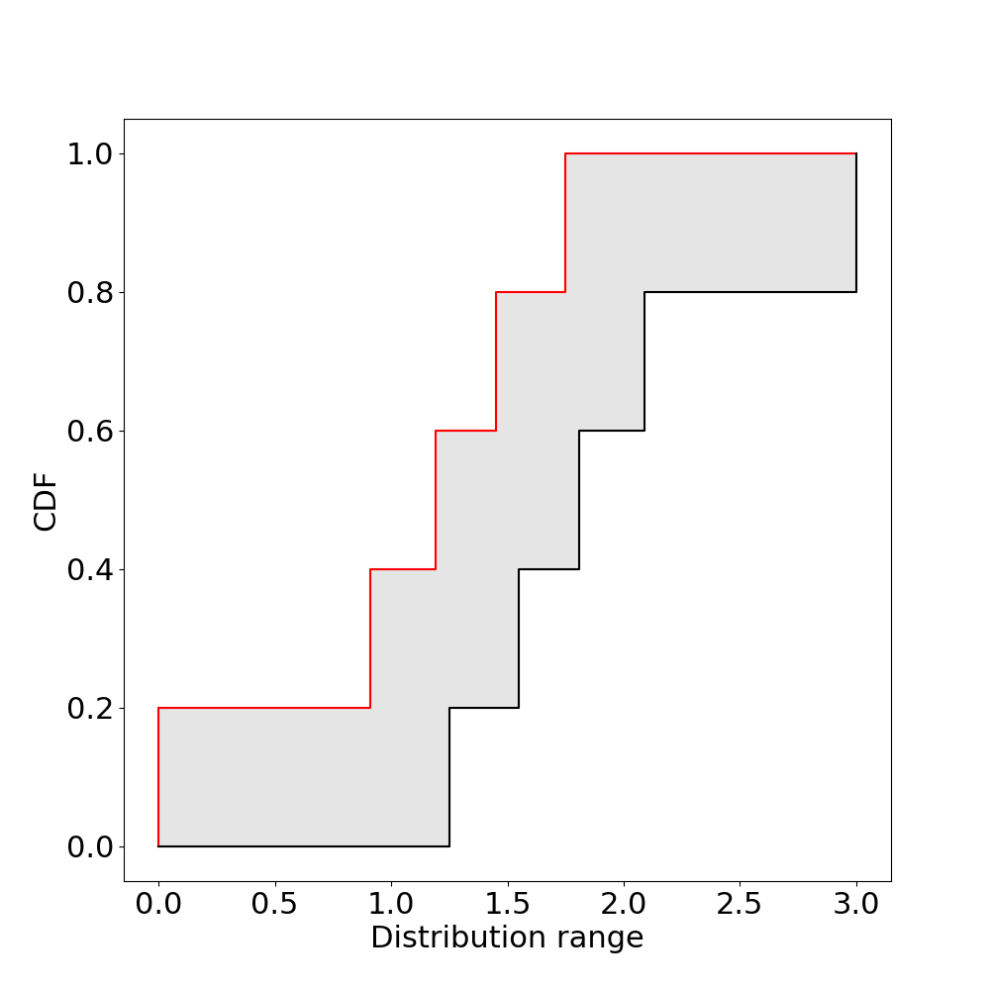


Probability Boxes
(p-box)
Inverse cdf bounds:
$$\underline{{F_{X}}^{∧}}≤{F_{X}}^{∧}≤\overline{{F_{X}}^{∧}}$$
$$\overline{F_{X}}$$
$$\underline{F_{X}}$$
Dual interpretation:
Interval $x$ for cdf value
Interval cdf for $x$
A distribution of intervals
    (Random Set)

Slide 16
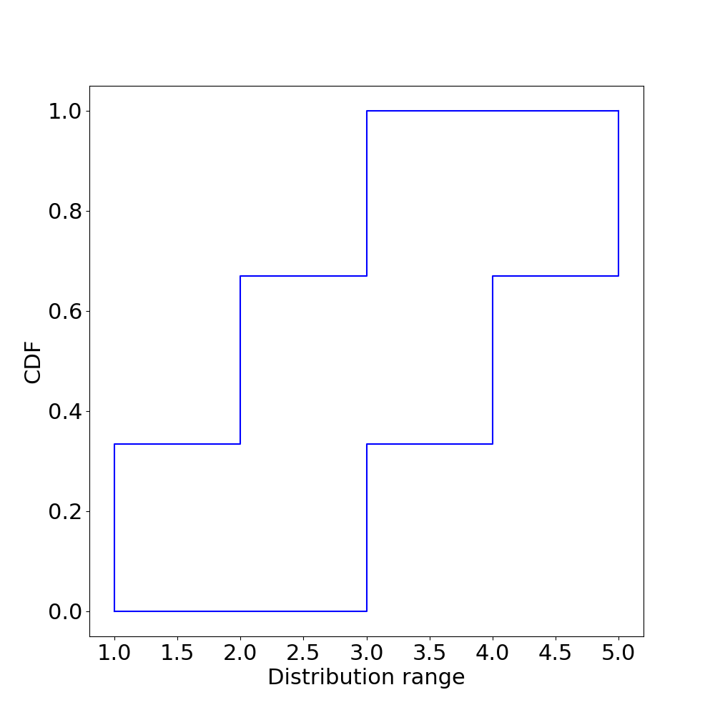
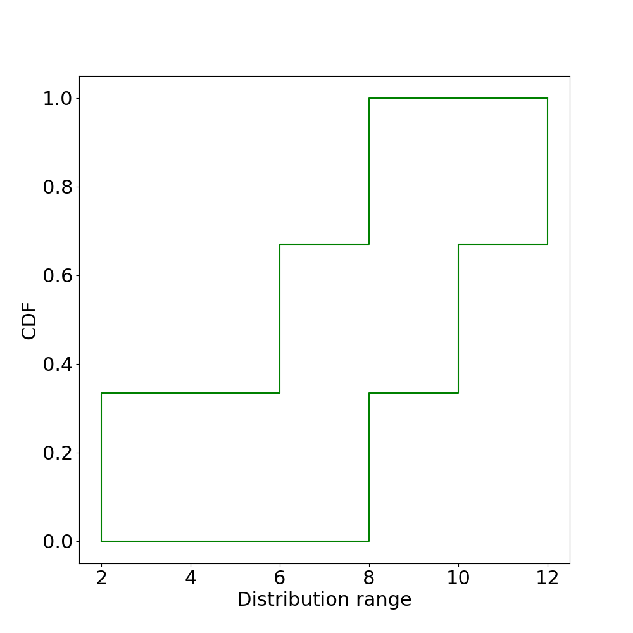
Probability Bounds Arithmetic
Variable A
Variable B
What can be said about A+B under independence?

Slide 17
Cartesian product
A+B
independence
A∈[1,3]
p₁ = 1/3
A∈[2,4]
p₂ = 1/3
A∈[3,5]
p₃ = 1/3
B∈[2,8]
q₁ = 1/3
A+B∈[3,11]
prob=1/9
A+B∈[4,12]
prob=1/9
A+B∈[5,13]
prob=1/9
B∈[6,10]
q₂ = 1/3
A+B∈[7,13]
prob=1/9
A+B∈[8,14]
prob=1/9
A+B∈[9,15]
prob=1/9
B∈[8,12]
q₃ = 1/3
A+B∈[9,15]
prob=1/9
A+B∈[10,16]
prob=1/9
A+B∈[11,17]
prob=1/9

Slide 18
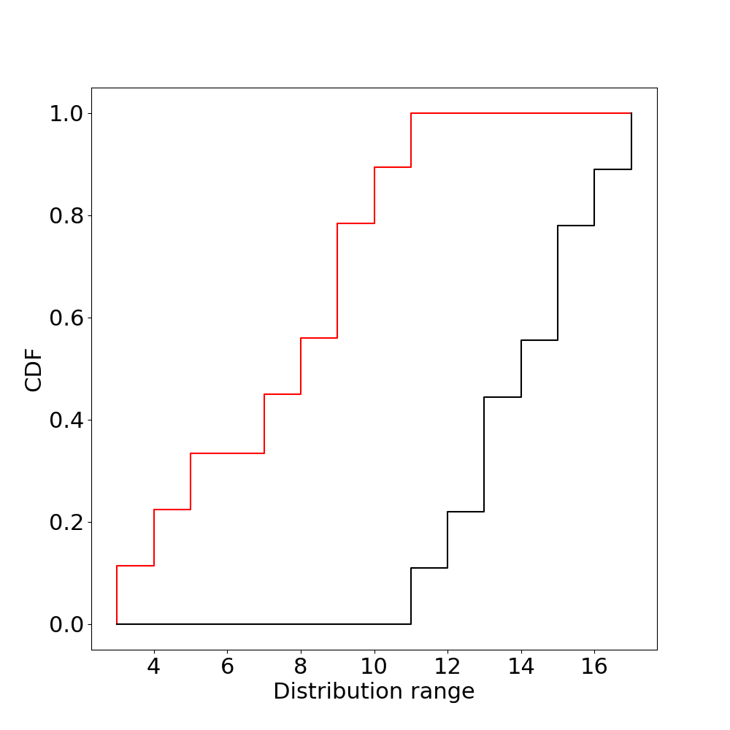
A + B under independence

Slide 19
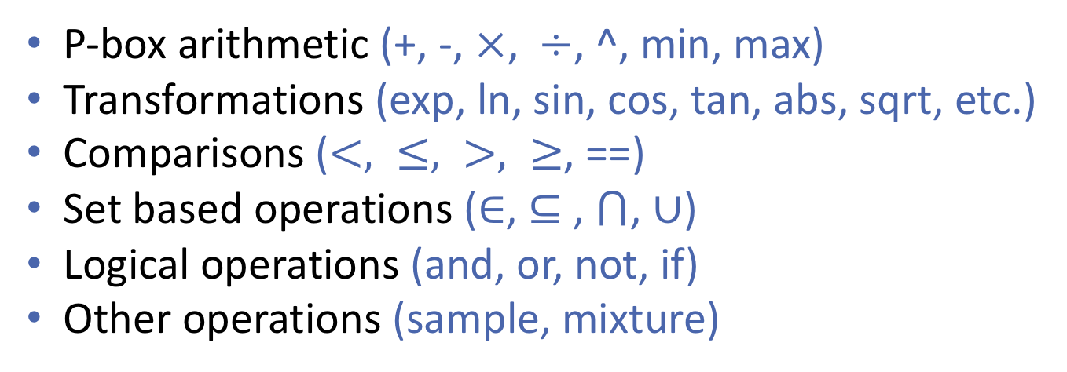
Probability Bounds Arithmetic
P-box arithmetic (+, -, $×$, $÷$, ^, min, max)
Transformations (exp, ln, sin, cos, tan, abs, sqrt, etc.)
Comparisons ($<, ≤, >, ≥$, ==)
Set based operations ($∈$, $⊆$ , $⋂$, $∪$)
Logical operations (and, or, not, if)
Other operations (sample, mixture)

Slide 20
Where do p-boxes come from?

Slide 21
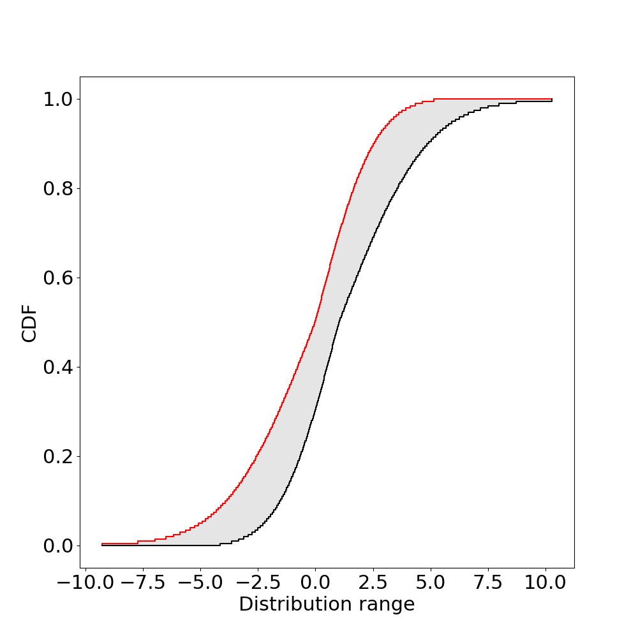
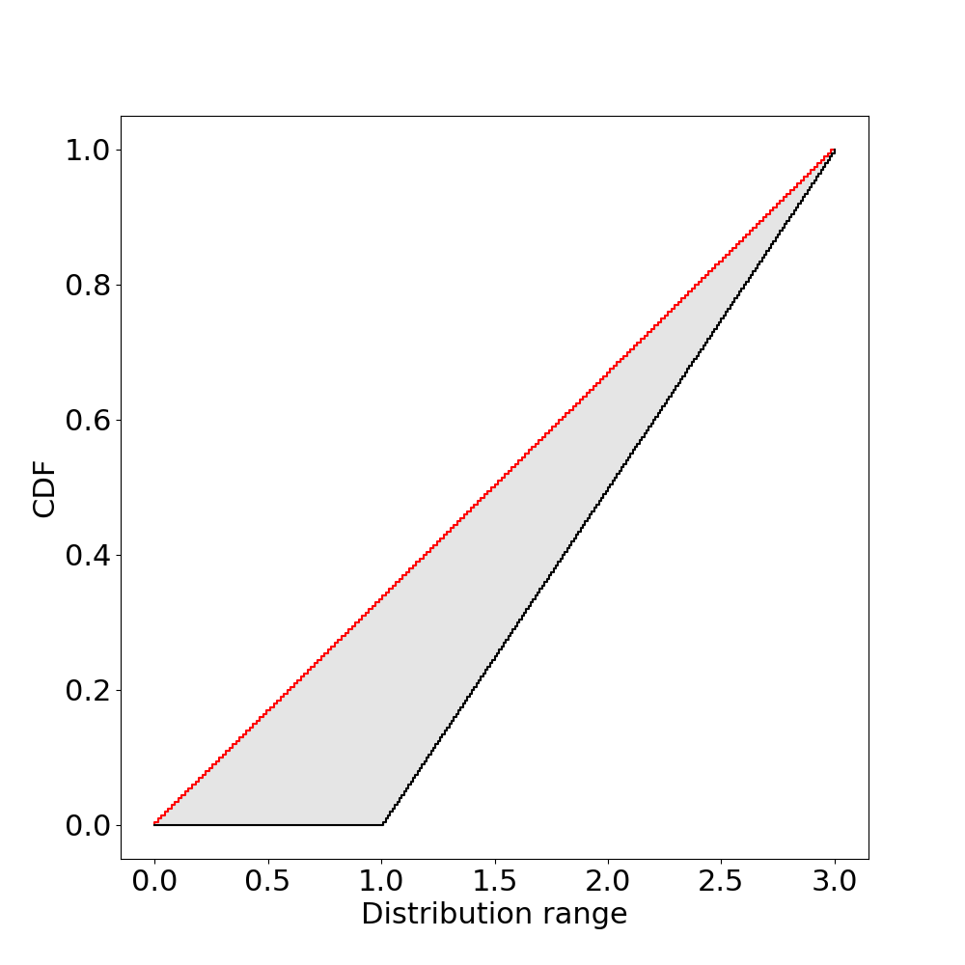
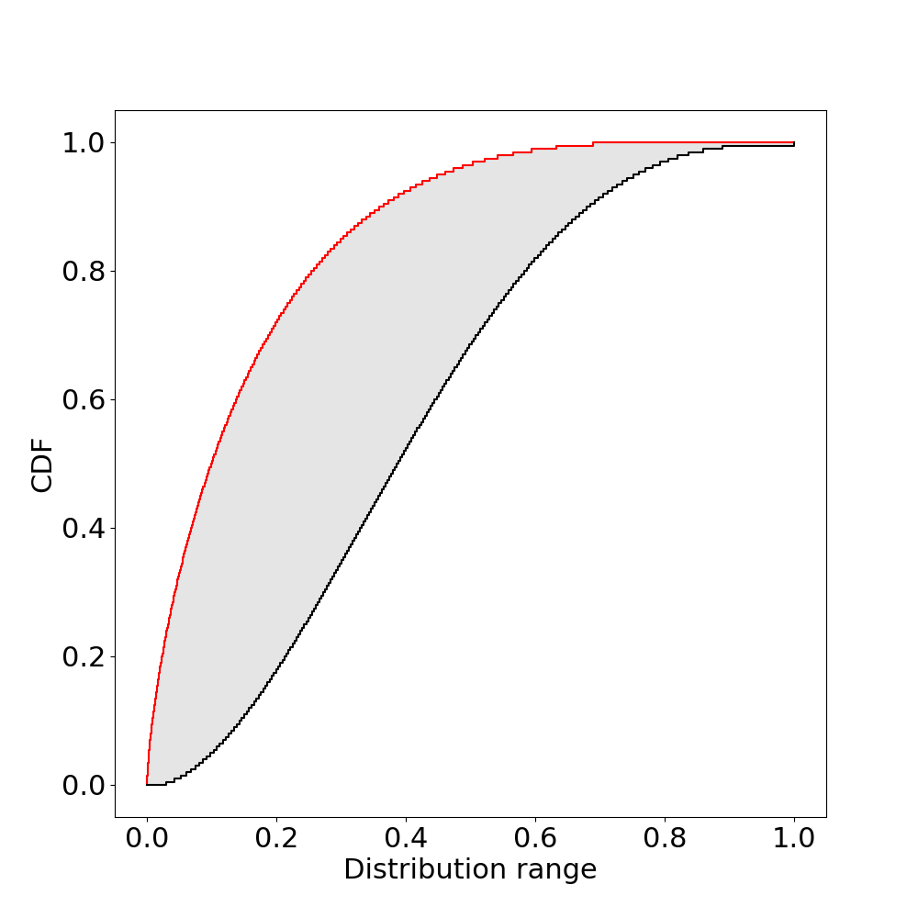
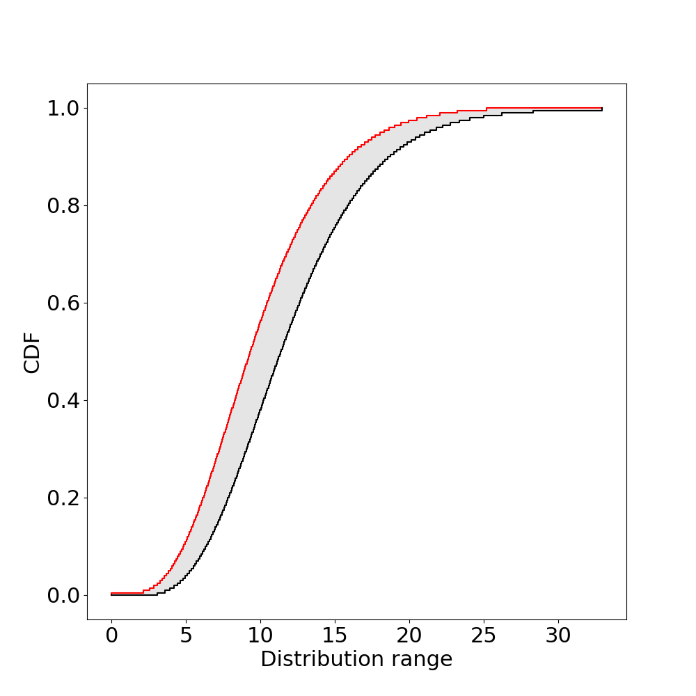
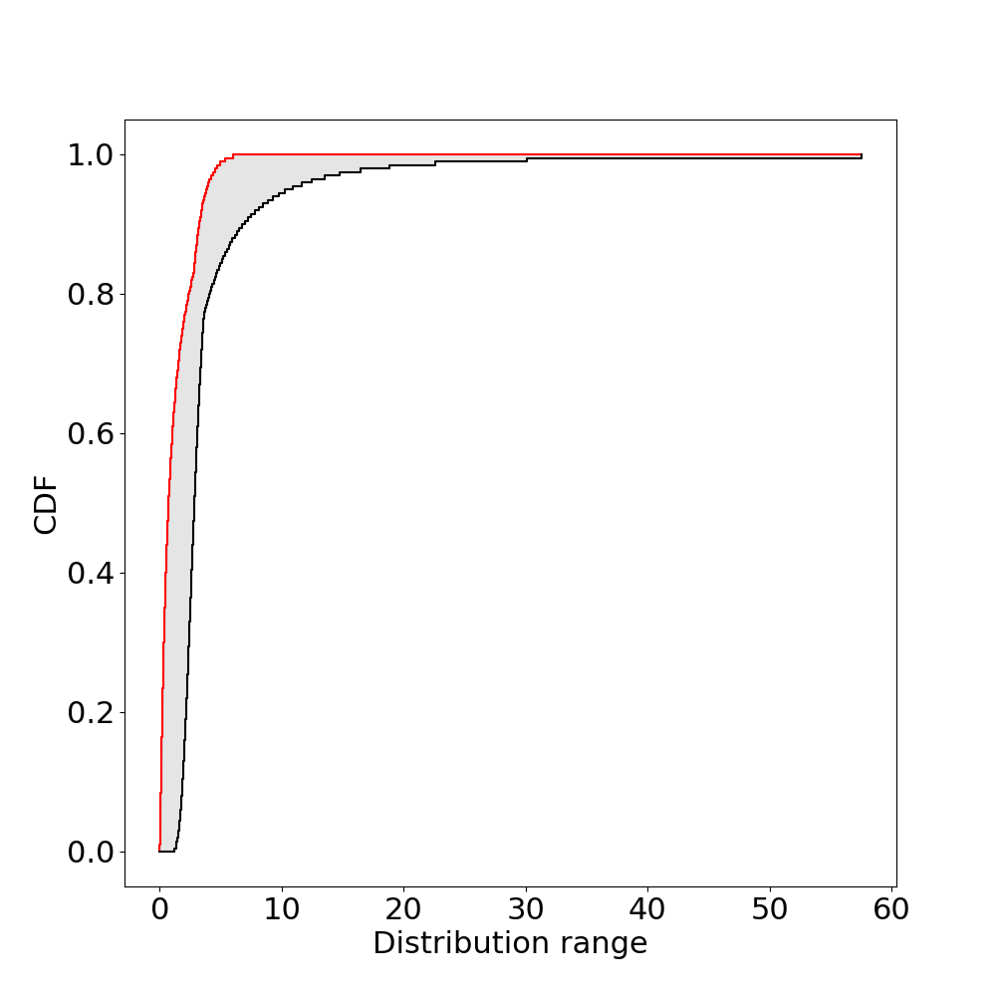
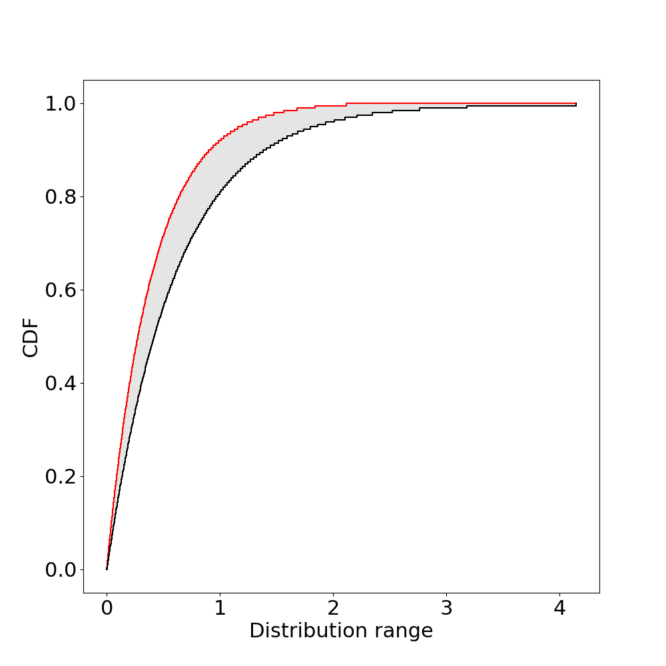
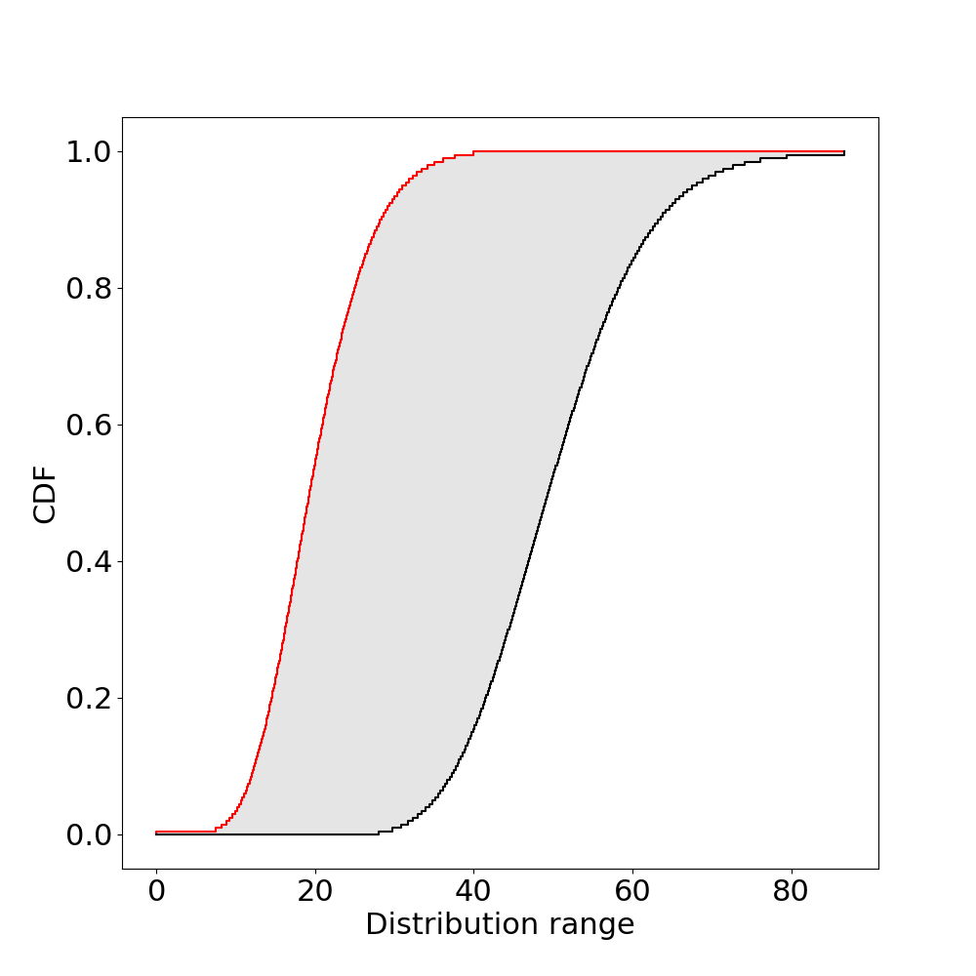
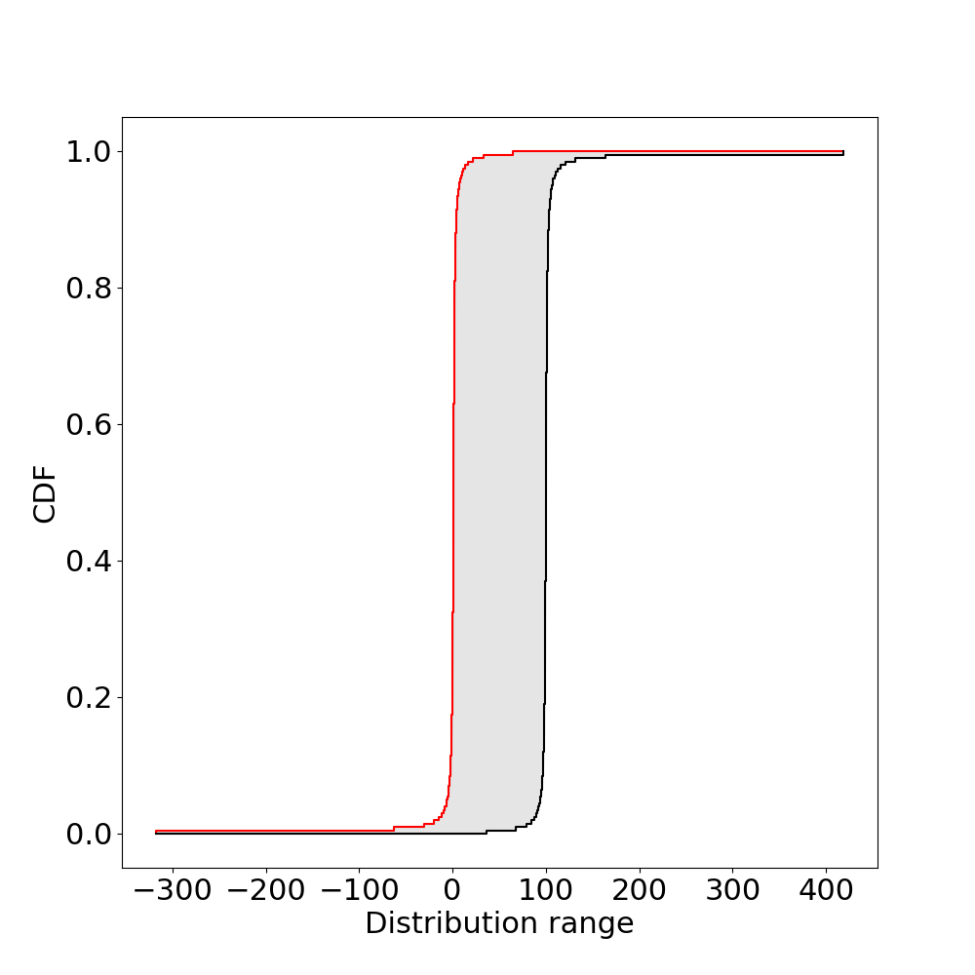








Distributions with unknown parameters
Normal
Uniform
Beta
Gamma
$$μ∈\left[0,1\right], σ∈[2,3]$$
$$U_{1}∈\left[0,1\right], U_{2}=3$$
$$α∈\left[0.7, 1\right], β∈[3,4]$$
$$α∈\left[5, 6\right], β=2$$
Lognormal
Exponential
Chi squared
Cauchy
$$μ∈\left[2,3\right], σ∈[1,5]$$
$$λ∈\left[0.4,0.6\right]$$
$$k∈\left[20,50\right]$$
$$α∈\left[1,100\right], β=1$$

Slide 22
Limited data
1.0
Kolmogorov-Smirnov
95% confidence bounds
0.8
0.6
Cumulative probability
0.4
0.2
N = 30
0.0
300
350
400
450
500

Slide 23
Robust Bayesian Analysis
Posterior p-box
Posteriors
Priors
Likelihoods
-5
0
5
10
15
20
class of priors, class of likelihoods ⇒ class of posteriors

Slide 24
1
Partial information about distributions
1
1
p-box
mean, std
range, quantile
min,max
0
0
0
Max entropy
2
4
6
8
10
-10
0
10
20
0
10
20
30
40
50
1
1
1
min,
max, mean
sample data, range
integral, min,max
0
0
0
2
4
6
8
10
2
4
6
8
10
2
4
6
8
10
1
1
1
min, mean
min,max, mean,std
p-box
0
0
0
0
10
20
30
40
50
2
4
6
8
10
2
4
6
8
10

Slide 25
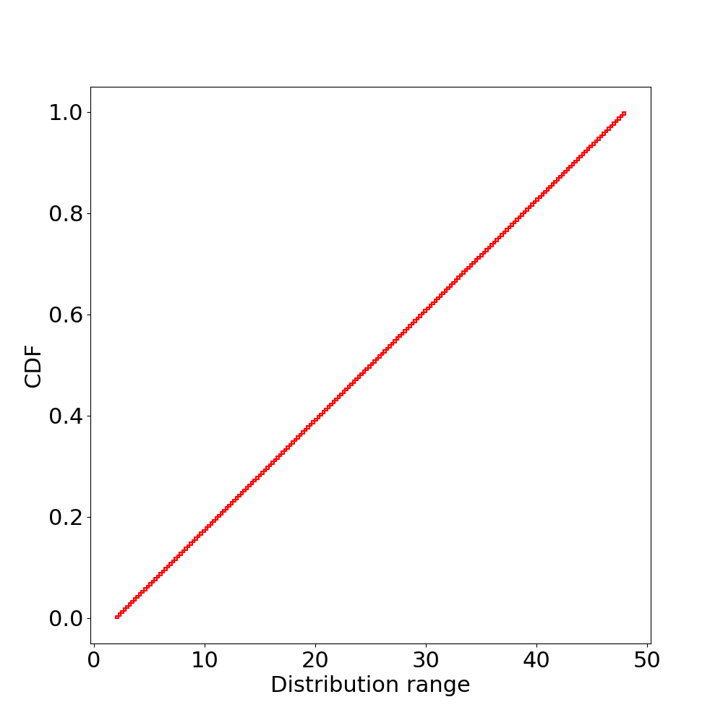
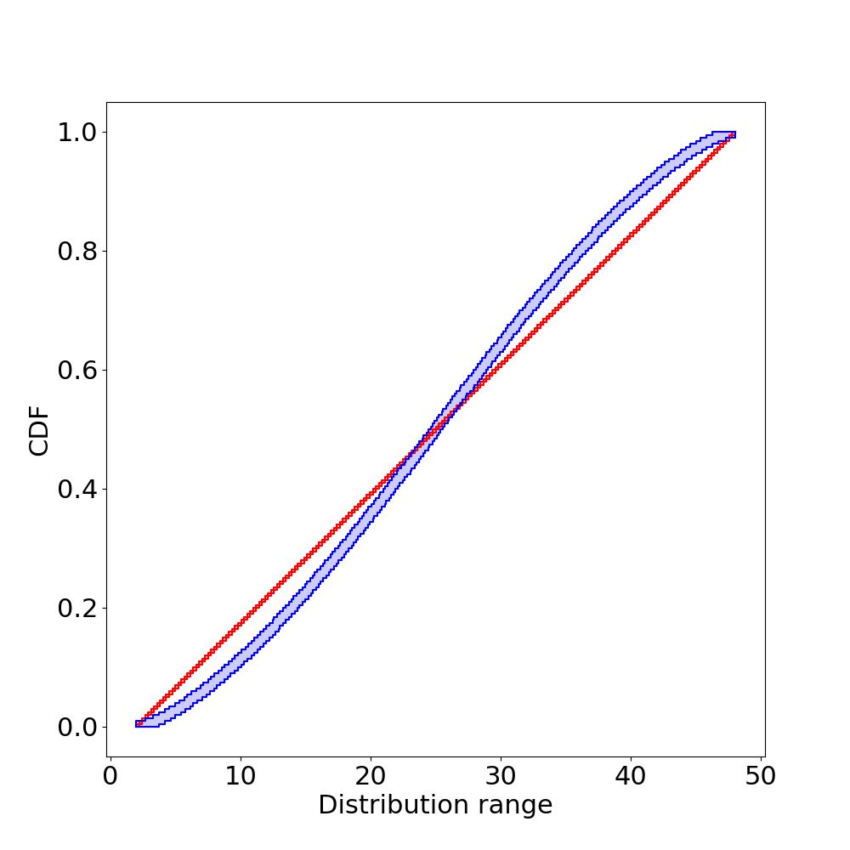
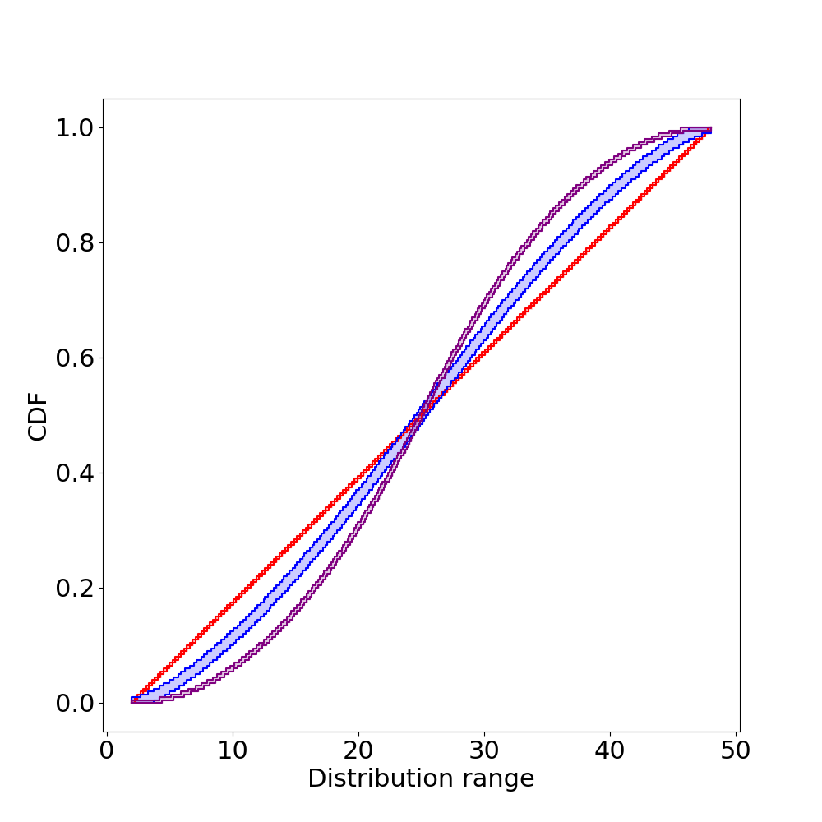
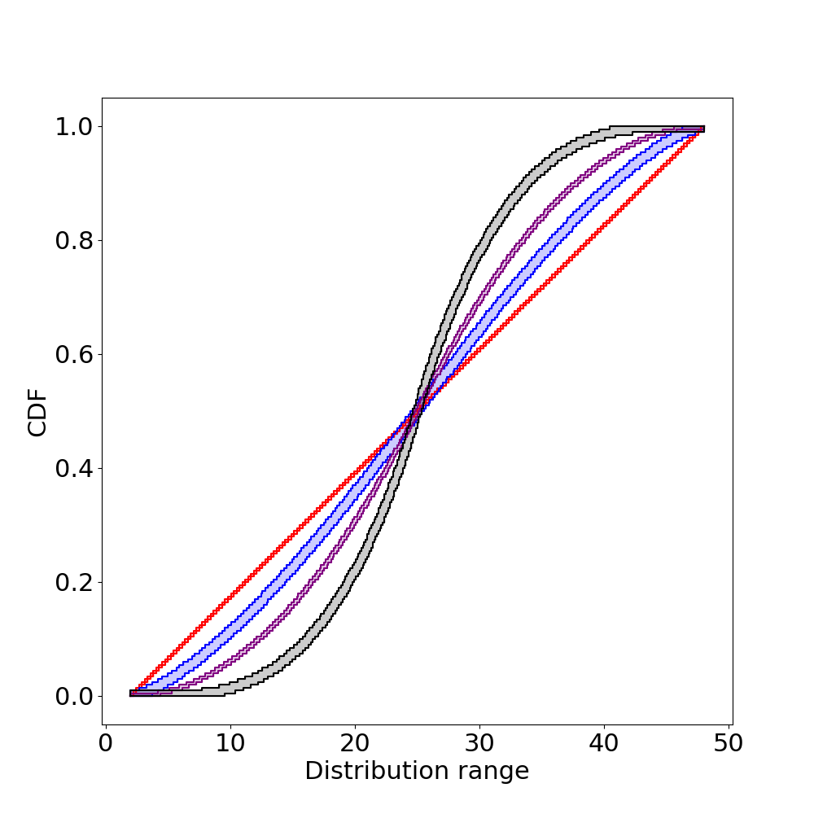
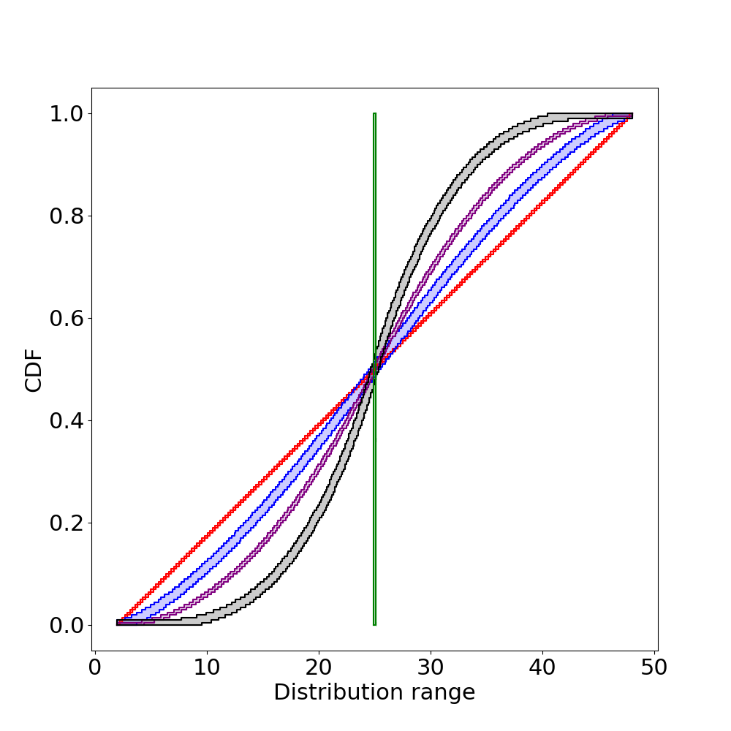


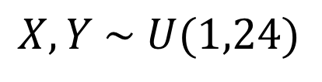



Arithmetic with unknown dependencies
X + Y with different gaussian copulas
$$ρ=−1$$
$$X, Y \sim U(1,24)$$
$$ρ=−0.5$$
$$ρ=0$$
$$ρ=0.5$$
$$ρ=1$$

Slide 26
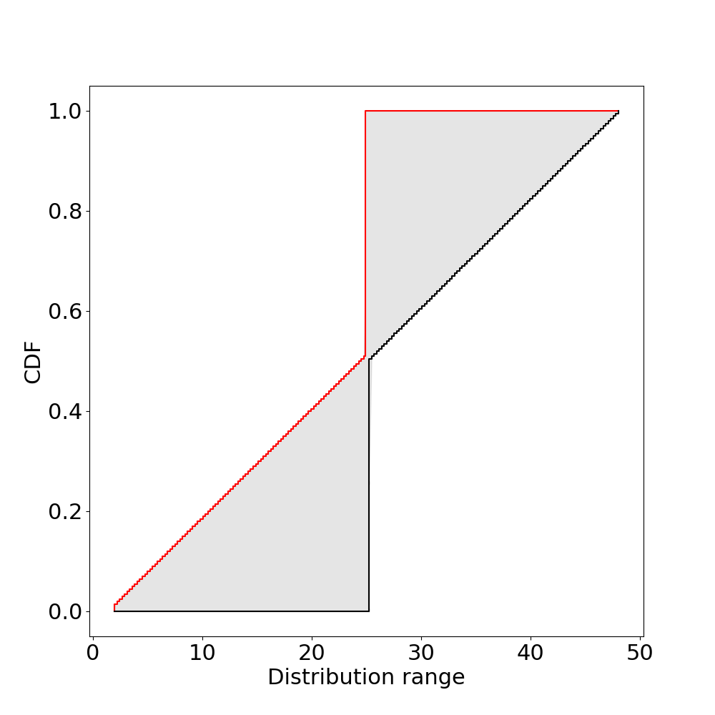
Arithmetic with unknown dependencies
X + Y with different gaussian copulas
$$X, Y \sim U(1,24)$$
Arithmetic with bounds on :
    all gaussian copulas

Slide 27
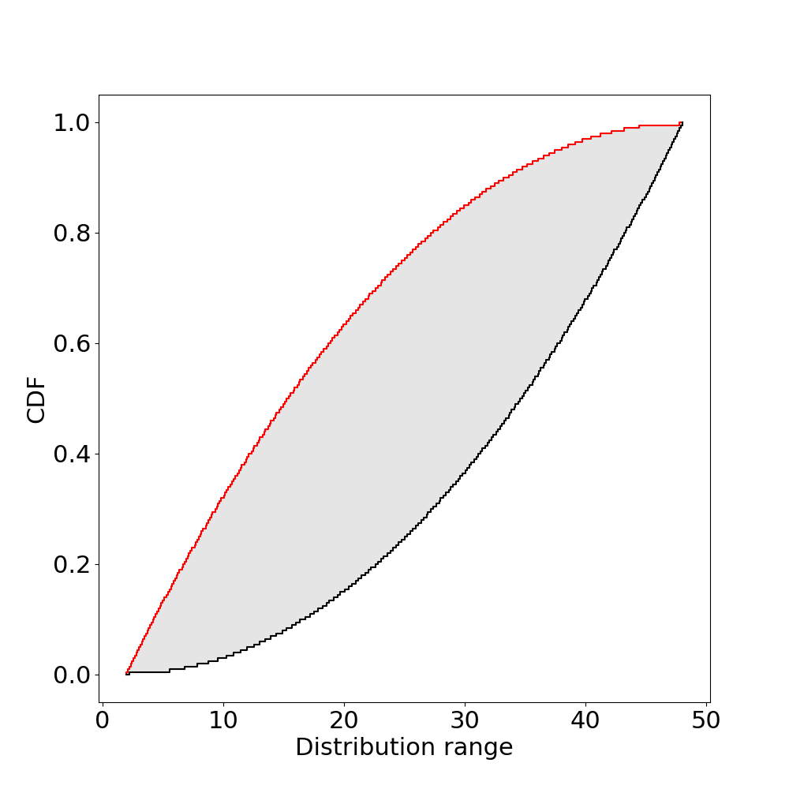
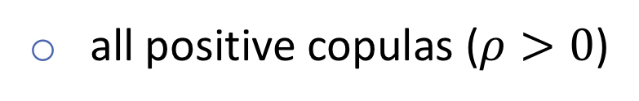
Arithmetic with unknown dependencies
X + Y with different gaussian copulas
$$X, Y \sim U(1,24)$$
Arithmetic with bounds on :
    all gaussian copulas
all positive copulas ($ρ>0$)

Slide 28
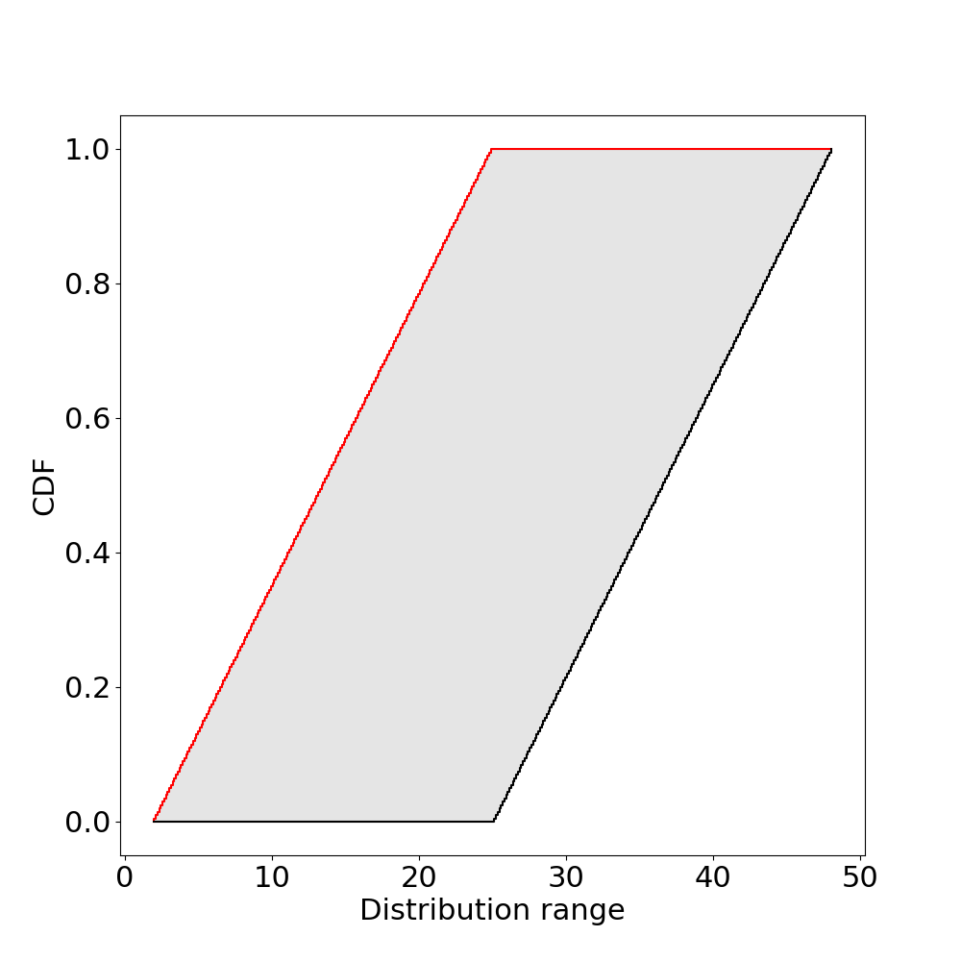
Arithmetic with unknown dependencies
X + Y with different gaussian copulas
$$X, Y \sim U(1,24)$$
Arithmetic with bounds on:
    all gaussian copulas
all positive copulas ($ρ>0$)
all dependencies

Slide 29
Total daily intake from inhalation
R = normal(20, 2) //respiration rate, m³/day
C_{GL} = 2 //concentration at ground level, mg/m³
F_{inh} = uniform(0.46,1) //fraction of particulates retained in lung, [unitless]
ED = exponential(11) //exposure duration, years
EF = uniform(0.58, 1) //exposure frequency, fraction of a year
BW = normal(64.2, 13.19) //receptor body weight, kg
AT = gumbel(70, 8) //averaging time, years

Slide 30
Input distributions
1
R
1
F_{inh}
1
ED
0
0
0
10
20
30
0.4
0.6
0.8
1
0
20
40
60
1
EF
1
BW
1
AT
0
0
0
0.6
0.8
1
30
50
70
90
50
70
90
110

Slide 31
Results
1
If threshold is 2, assumption doesn’t matter
If threshold is 0.2, assumption matters a lot
Exceedance risk
All variables mutually independent
No assumptions about dependencies
0
0
1
2
TDI, mg kg⁻¹ day⁻¹

Slide 32
Conclusion
Framework for computing with sets of probabilities
P-boxes arise naturally:
      Limited data
      Distributions unknown (or partially)
      Dependencies unknown (or partially)
Method can be:
    intrusive (automatically verified probabilities)
    non intrusive (inner approximation)

Slide 33
Software
Julia: https://github.com/AnderGray/ProbabilityBoundsAnalysis.jl
Python: https://github.com/Institute-for-Risk-and-Uncertainty/pba-for-python
R: https://github.com/ScottFerson/pba.r
C++: RiskCalc (commercial)
Contact: Ander.Gray@Liverpool.ac.uk

Slide 34
References
p-boxes:
Ferson, Scott, et al. Constructing probability boxes and Dempster-Shafer structures. No. SAND-2015-4166J. Sandia National Lab.(SNL-NM), Albuquerque, NM (United States), 2015.
imprecise probabilities:
Beer, Michael, Scott Ferson, and Vladik Kreinovich. "Imprecise probabilities in engineering analyses." Mechanical systems and signal processing 37.1-2 (2013): 4-29.
dependencies, copulas:
Ferson, Scott, et al. Dependence in probabilistic modeling Dempster-Shafer theory and probability bounds analysis. No. SAND-2015-4167J. Sandia National Lab.(SNL-NM), Albuquerque, NM (United States), 2015.
Nelsen, Roger B. An introduction to copulas. Springer Science & Business Media, 2007.
Contact: Ander.Gray@Liverpool.ac.uk

Slide 35
Acknowledgements
Andrew Davis, Culham Centre for Fusion Energy, UKAEA
Edoardo Patelli, University of Strathclyde
Marco De Angelis, Institute for Risk and Uncertainty, University of Liverpool
Funding support from EUROATOM and EPSRC, through iCase studentship award and grand agreement No. 633053
Contact: Ander.Gray@Liverpool.ac.uk
Projects: https://github.com/AnderGray

Slide 36
Extra

Slide 37
Dependencies

Slide 38
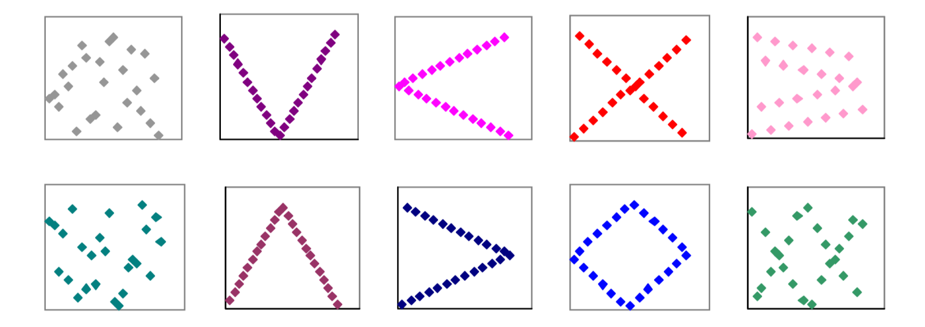
Correlation only says so much
Uncorrelated, but very dependent samples
Graphic from:
Dependence in probabilistic modeling, Dempster-Shafer theory, and probability bounds analysis,
S. Ferson, et al

Slide 39
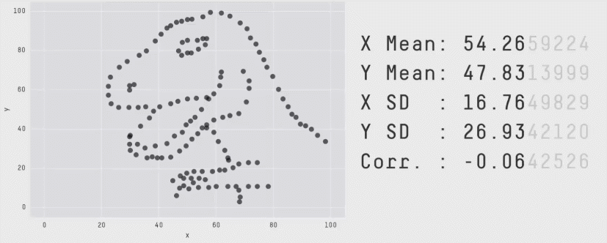
Correlation only says so much
https://www.autodeskresearch.com/publications/samestats

Slide 40
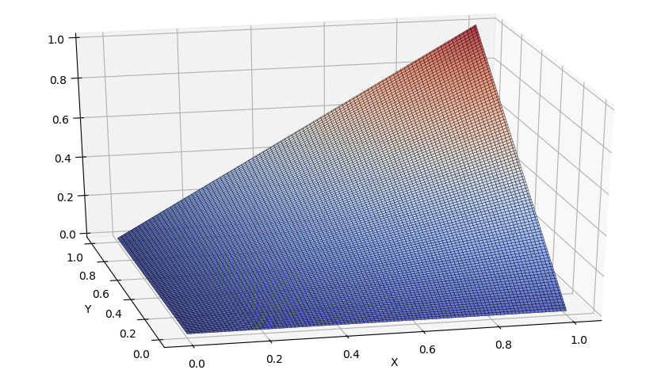
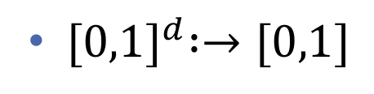
Copulas
Encode any dependency
2d cdfs with uniform marginals
${[0,1]}^{d} :→[0,1]$
v
u

Slide 41
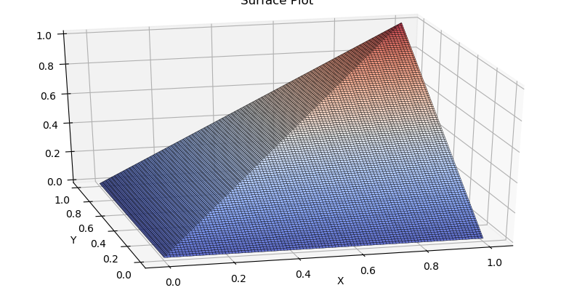
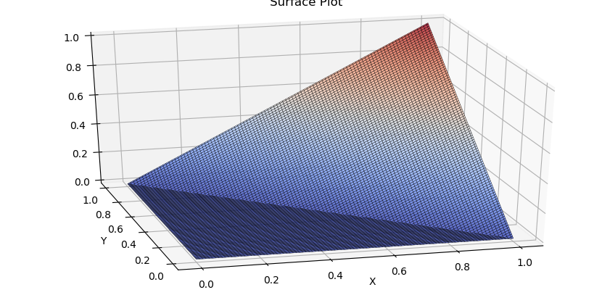

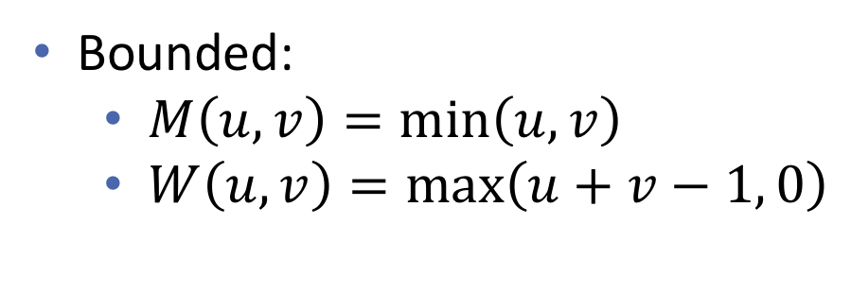

Copulas
Fréchet bounds
Encode any dependency
$$M(u,v)$$
2d cdfs with uniform marginals
Maximal correlation
${[0,1]}^{d} :→[0,1]$
v
u
Upper bound
$$W(u,v)$$
Bounded:
  $M\left(u,v\right)=\min\left(u,v\right)$
  $W\left(u,v\right)=\max\left(u+v−1, 0\right)$
Minimal correlation
Lower bound
v
u

Slide 42
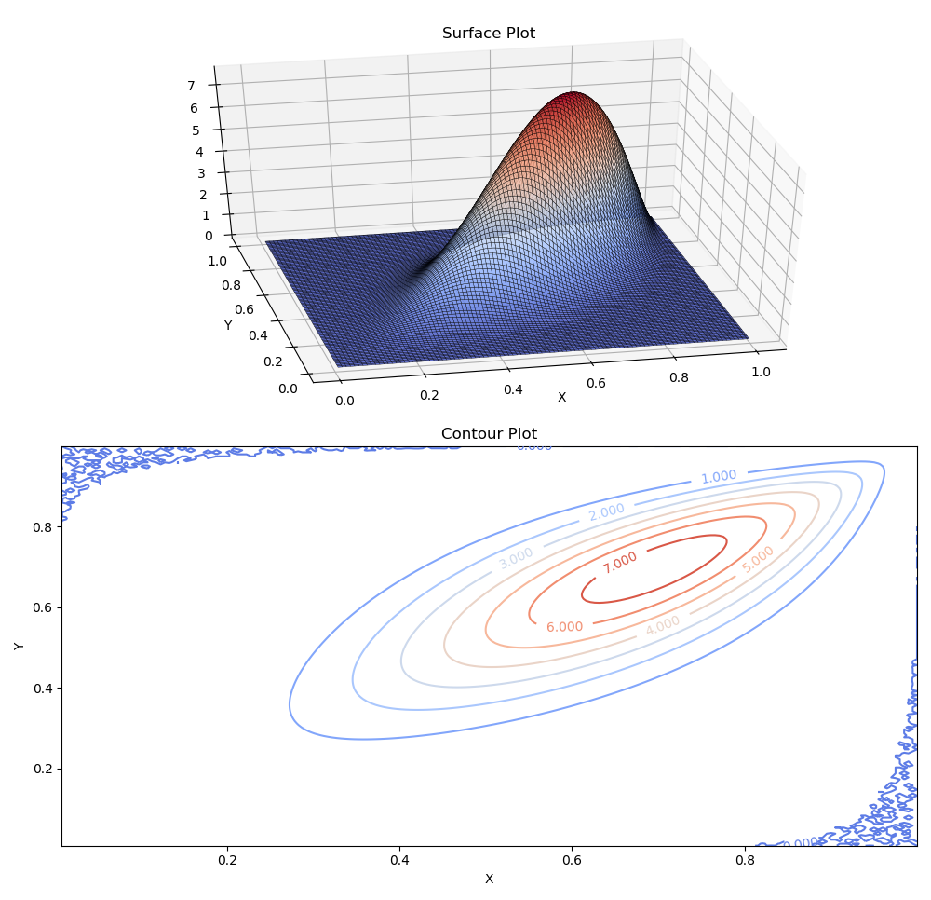
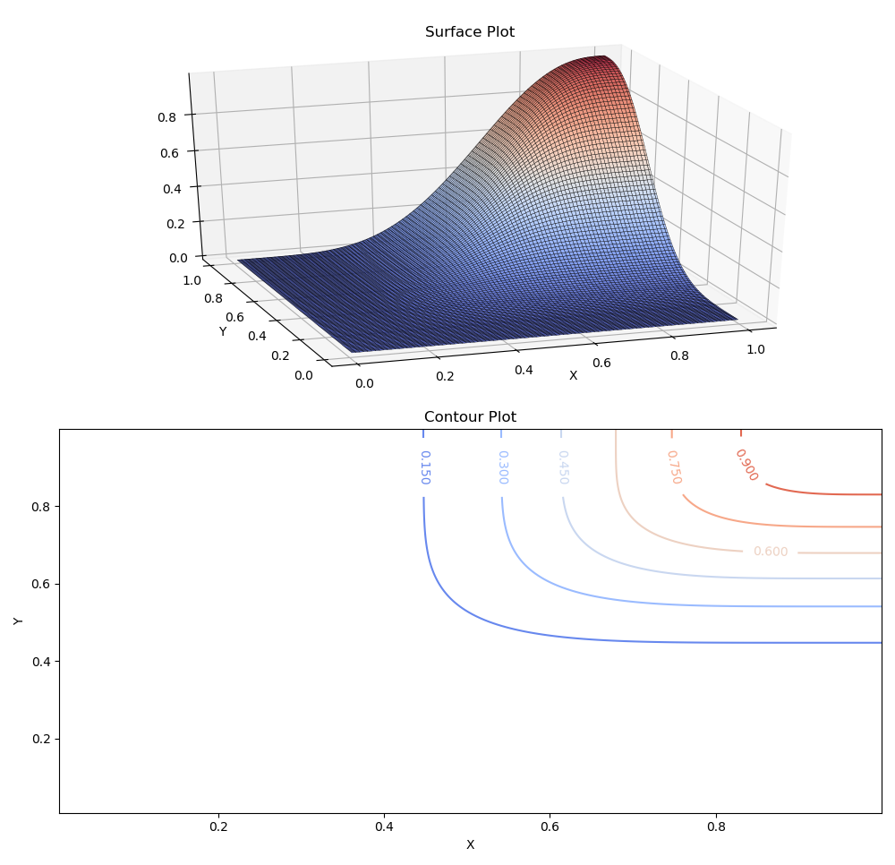
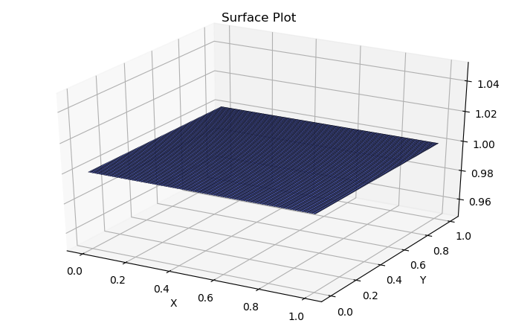
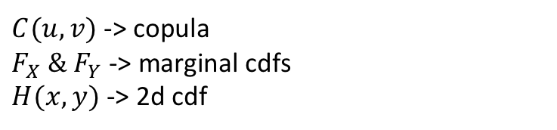
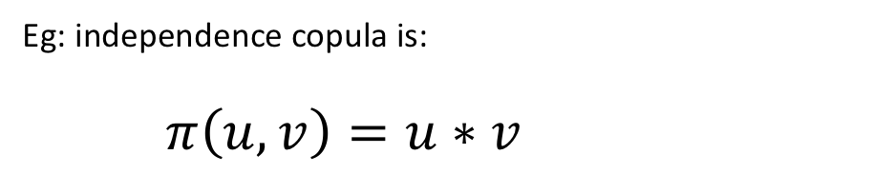
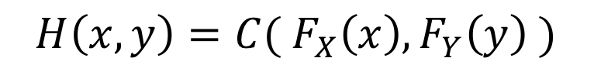
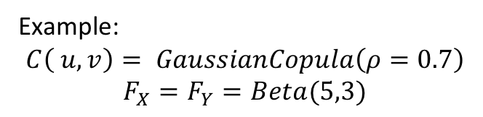
Example:
$$C\left( u,v\right)= GaussianCopula\left(ρ=0.7\right)$$
$$F_{X}=F_{Y}=Beta(5,3)$$
Copulas
CDF
Generalises dependence
Eg: independence copula is:
$π\left(u,v\right)=u∗v$
v
u
“Couple” distributions together
Density
$$H\left(x,y\right)=C({ F}_{X}\left(x\right), F_{Y}\left(y\right) )$$
$C(u,v)$ -> copula
$F_{X} \& F_{Y}$ -> marginal cdfs
$H(x,y)$ -> 2d cdf
v
u

Slide 43
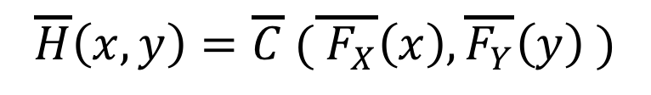
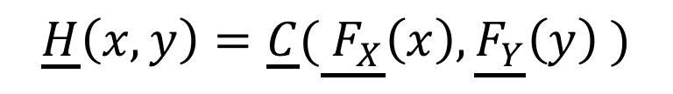
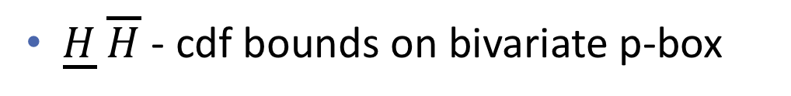
Bounds on joint distributions
Bivariate p-boxes:
$$\underline{H}\left(x,y\right)=\underline{C}(\underline{{ F}_{X}}\left(x\right),\underline{F_{Y}}\left(y\right) )$$
$$\overline{H}\left(x,y\right)=\overline{C} (\overline{{ F}_{X}}\left(x\right),\overline{F_{Y}}\left(y\right) )$$
$\underline{H}$ $\overline{H}$ - cdf bounds on bivariate p-box
$\underline{C}$ $\overline{C}$ - bound on a set of copulas (imprecise copula)

Slide 44
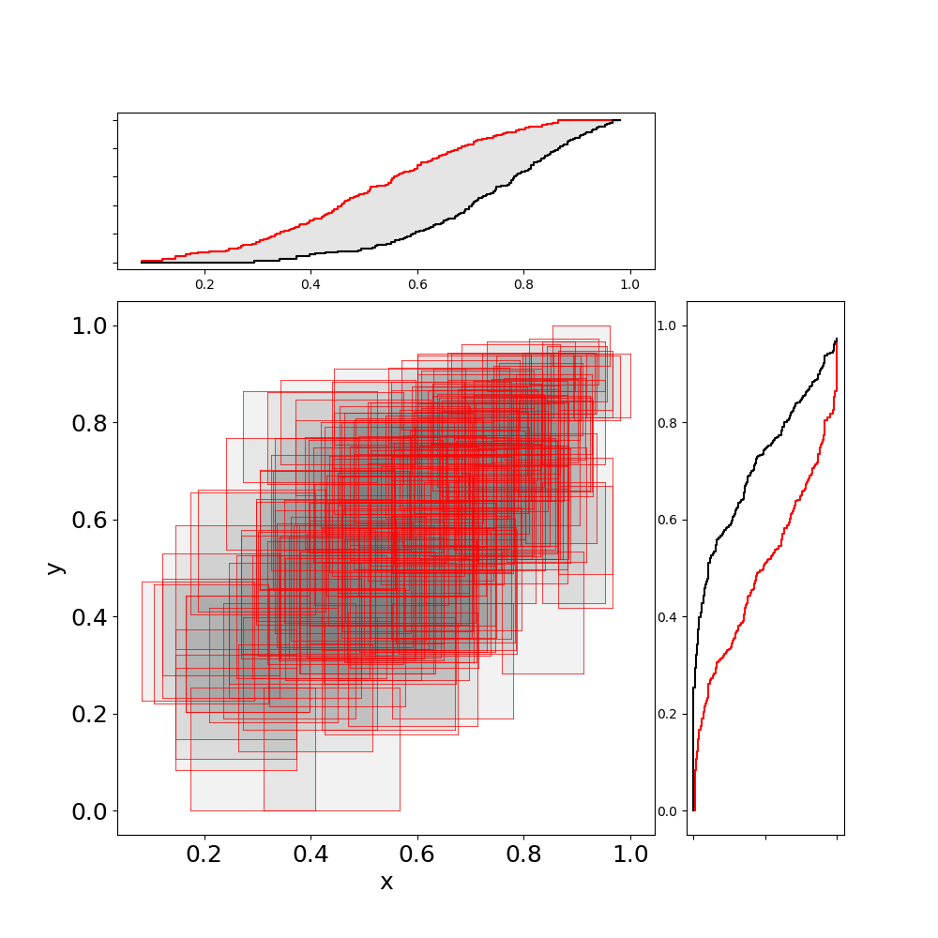
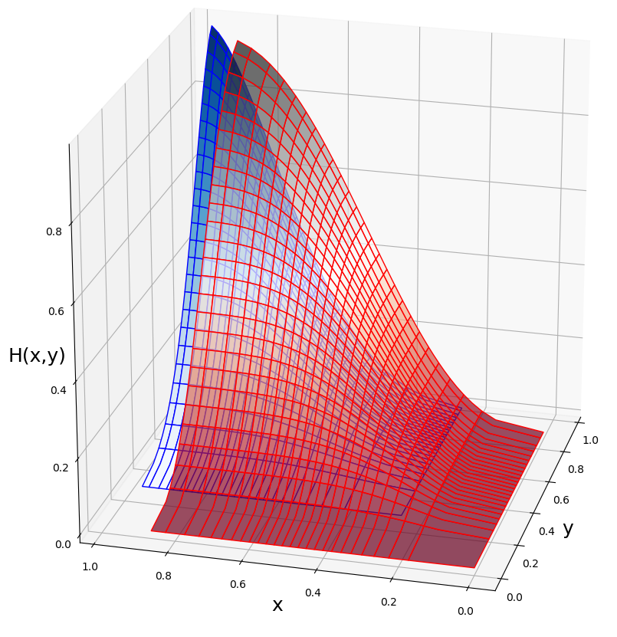
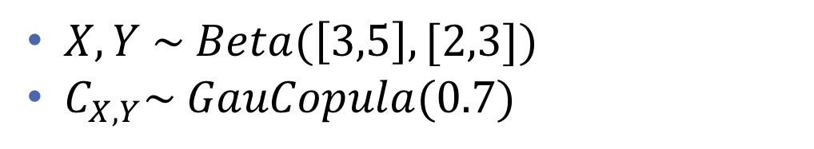
Bounds on joint distributions
$X,Y \sim Beta(\left[3,5\right], [2,3])$
$C_{X,Y}\sim GauCopula(0.7)$
Samples of bivariate p-box (random set)
CDF bounds

Slide 45
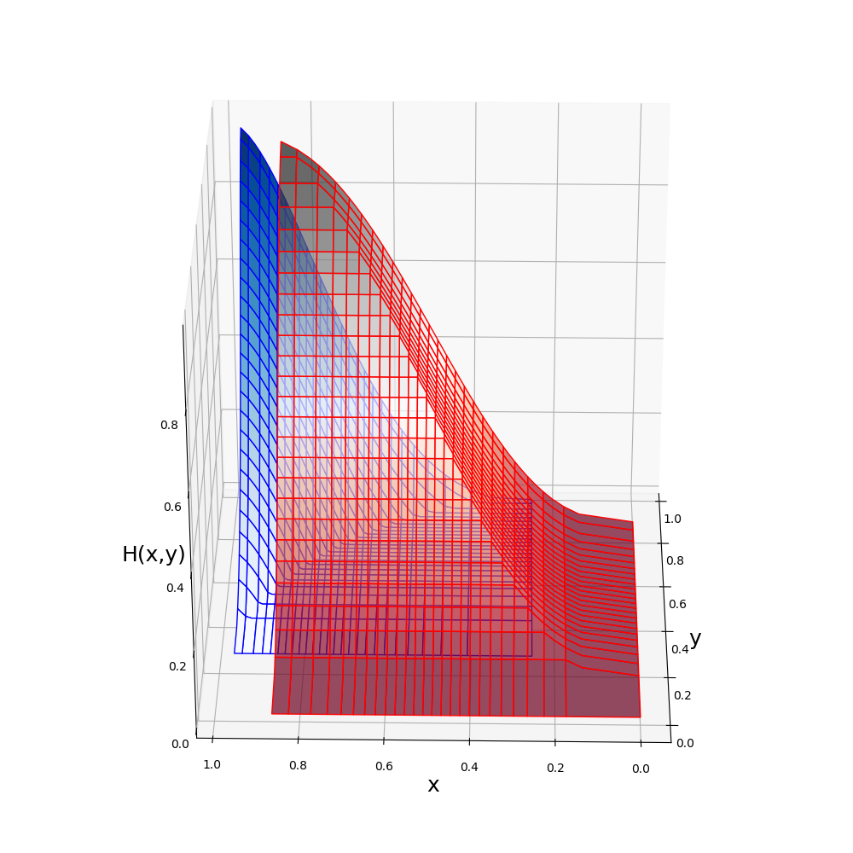
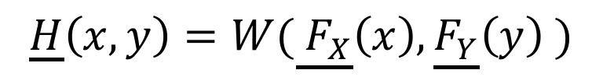

Bounds on joint distributions
Bivariate p-box with unknown dependency
$$\underline{H}\left(x,y\right)=W(\underline{{ F}_{X}}\left(x\right),\underline{F_{Y}}\left(y\right) )$$
$$\overline{H}\left(x,y\right)=M (\overline{{ F}_{X}}\left(x\right),\overline{F_{Y}}\left(y\right) )$$

Slide 46


Arithmetic using copulas

Slide 47


Arithmetic using copulas

